Slide 1




ASMITA Humber Practical
The ASMITA model Aggregated Scale Morphological Interaction between a Tidal inlet and the Adjacent coast
Also referred to as an:
Aggregated, Box, Lumped parameter, or Semi-empirical model
Prof. Ian Townend
With acknowledgements to:

Slide 2
ASMITA
Aggregated Scale Morphological Interaction between a Tidal inlet and the Adjacent coast
Model sediment exchange between elements
Notes:
The ASMITA model consider large scale volume and area changes within estuaries and tidal inlets. Recent additions include saltmarsh elements and storage elements to represent breaches in sea walls as frequently adopted for managed realignment sites.

Slide 3
Getting started
Asmita is installed as an App and requires muitoolbox and dstoolbox to be installed.
The download for each of these includes the code, documentation and example files. The files required are:
dstoolbox: dstoolbox.mltbx
muitoolbox: muitoolbox.mltbx
The App file: Asmita.mlappinstall
Installing the toolboxes
The toolboxes can be installed using the Add-Ons>Manage Add-Ons option on the Home tab of MatlabTM. Alternatively, right-click the mouse on the ‘mltbx’ files and select install.
All the folder paths are initialised upon installation and the location of the code is also handled by Matlab™.
The location of the code can be accessed using the options in the Manage Add-Ons UI.
Installing the App
The App is installed using the Install Apps button on the APPS tab in Matlab™. Alternatively, right-click the mouse on the ‘mlappinstall’ file and select install.
Again all the folder paths are initialised upon installation and the location of the code is handled by Matlab™.
Once installed, the demonstration model can be run from the Command Window using:
>> Asmita;
Documentation can be viewed from the Supplementary Software in the Matlab™ documentation. The location of the code can be accessed by hovering over the App icon and then finding the link in the pop-up window.

Slide 4
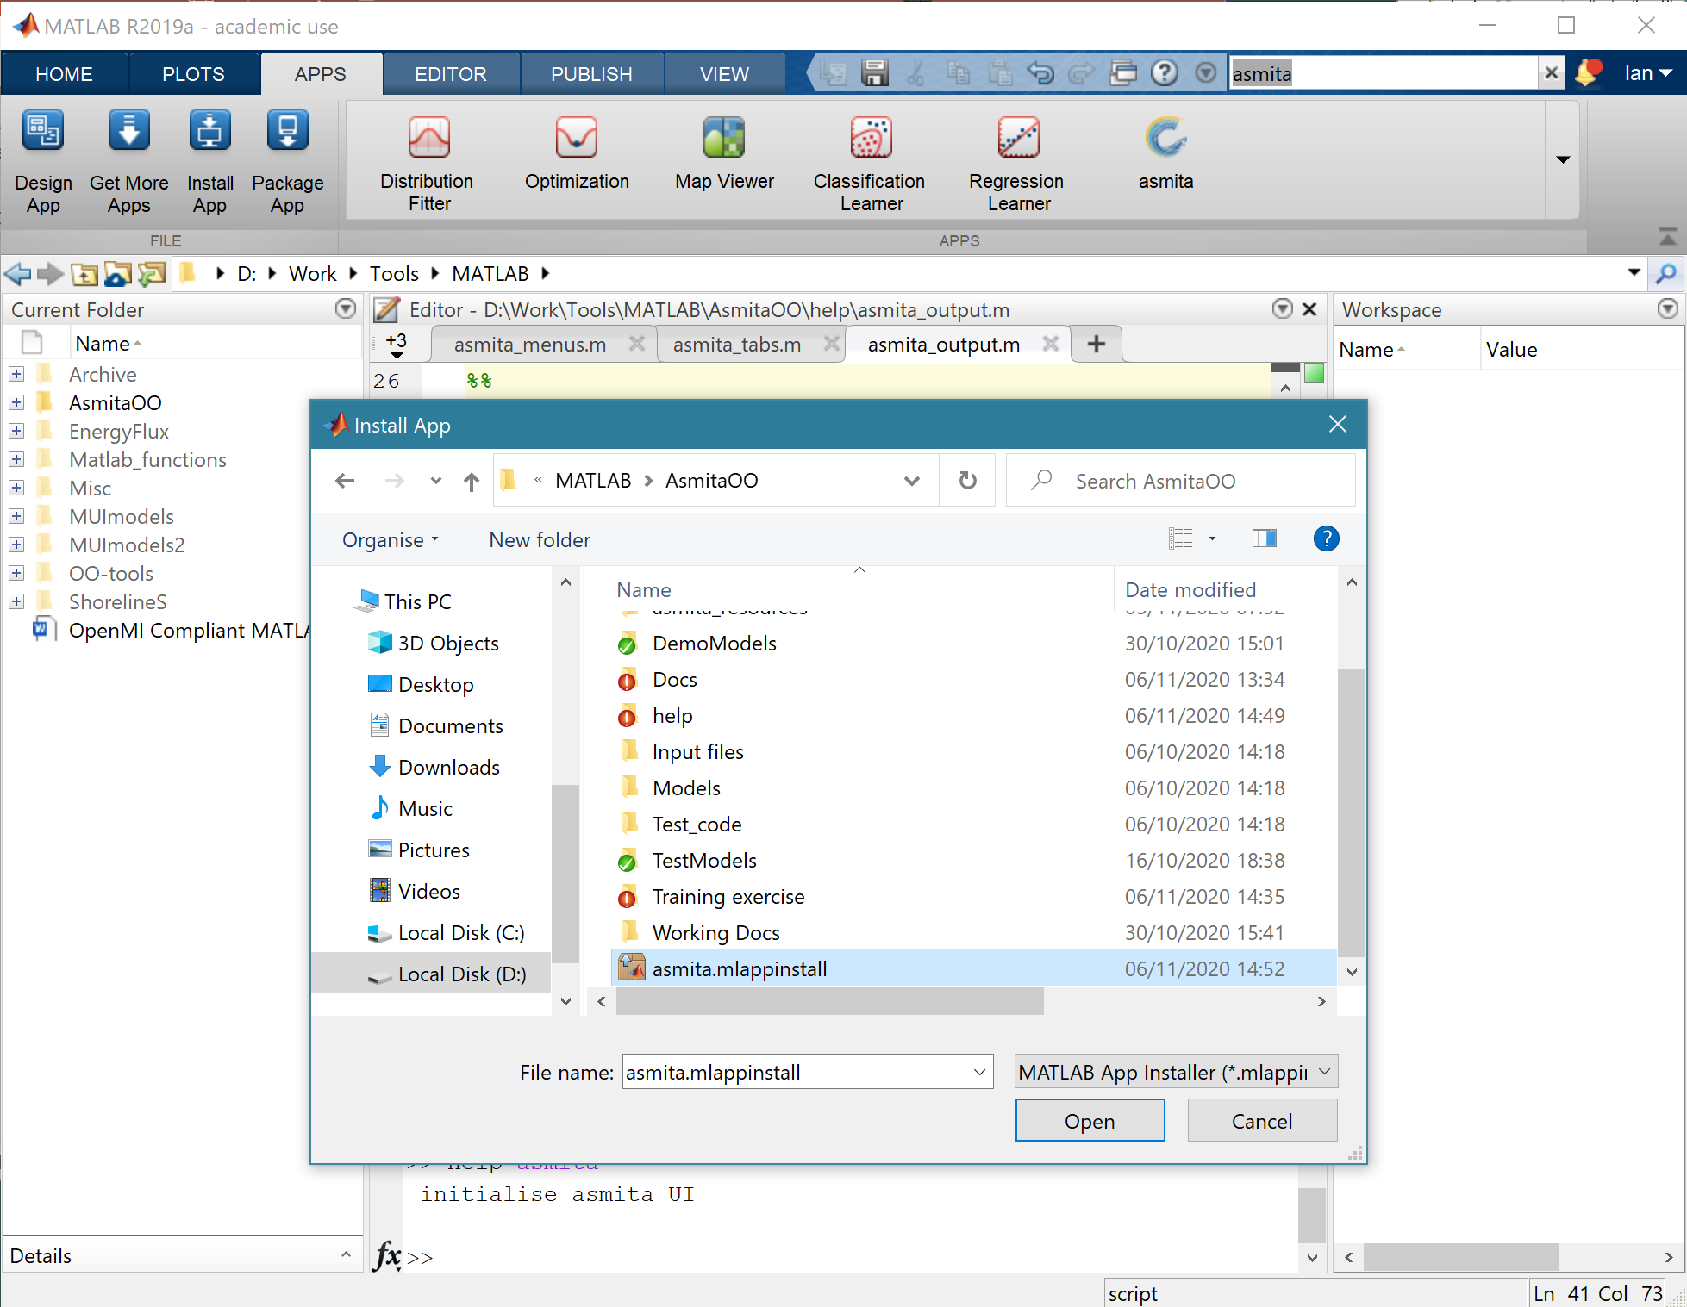
Install the ASMITA App
Download ASMITA from www.coastalsea.uk/downloads
Install the asmita App from the APPS tab
Select the file: asmita.mlappinstall

Slide 5
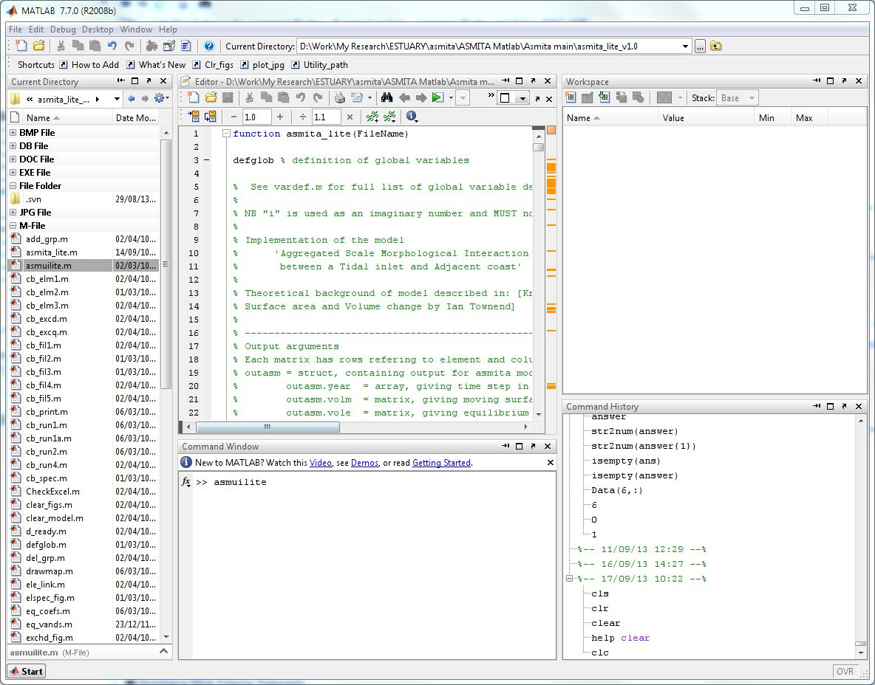
Run ASMITA
Locate working directory
Start from command line with >>Asmita;

Slide 6
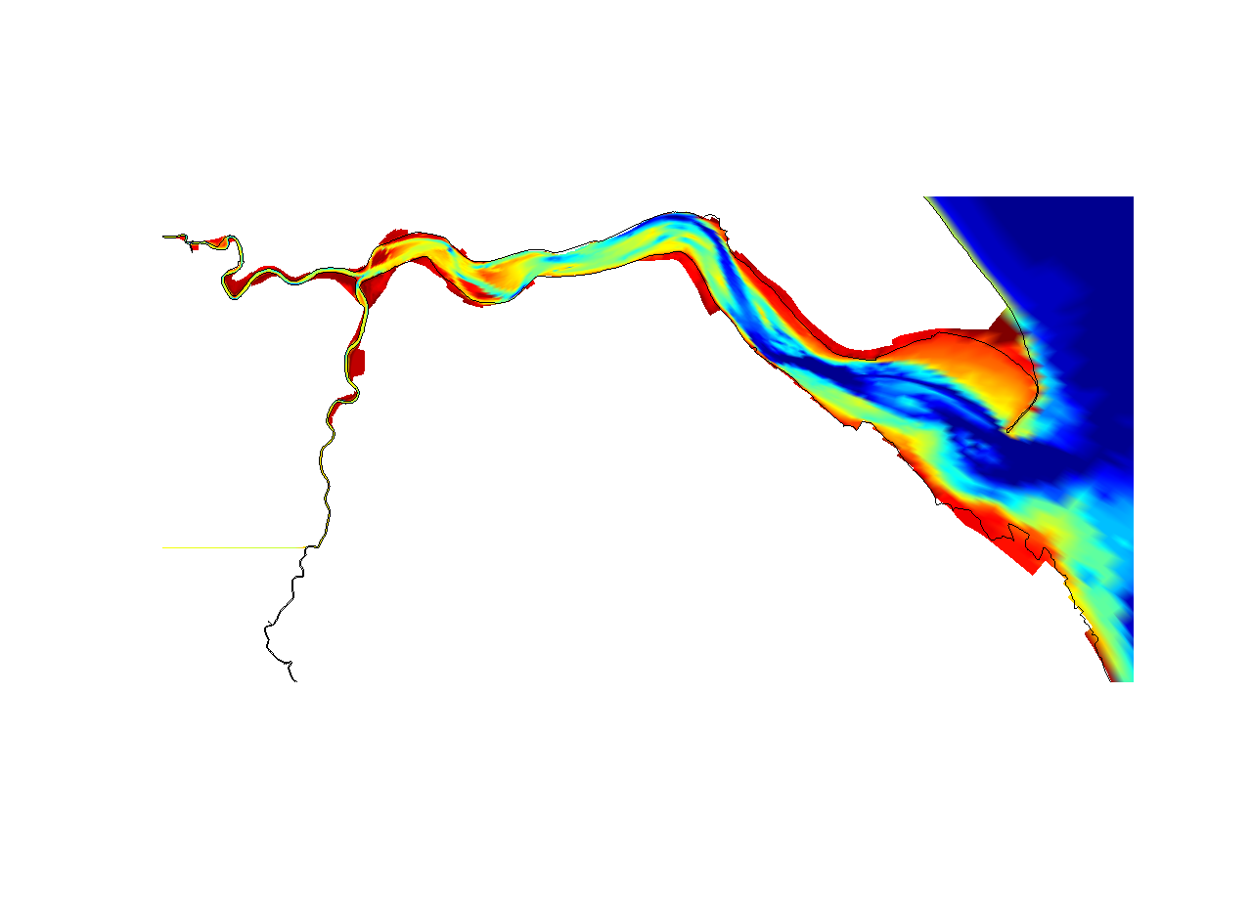
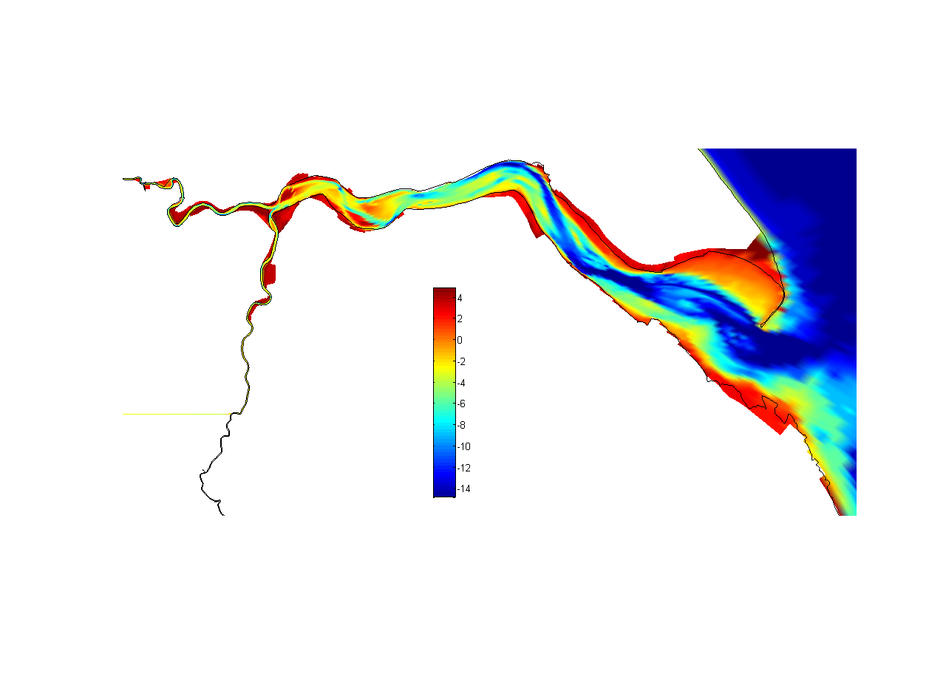

Humber Estuary
River Ouse
Hull
Brough
Spurn Head
Trent Falls
Read’s Island
Immingham
River Trent
Grimbsy
2000 Bathymetry
10 km
Notes:
Applying this model to a real case we make use of the Humber estuary for which there is an extensive historic data set.
The model was set up by sub-dividing the estuary into 7 reaches, although given the time I will only present the cumulative results.

Slide 7
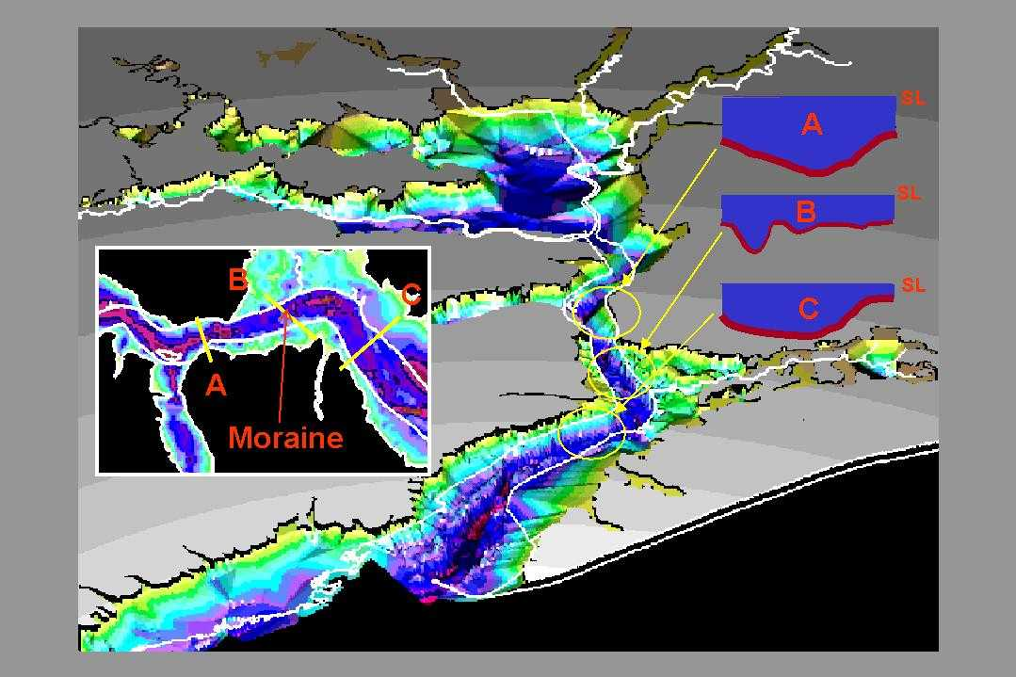
Geological setting
Figure shows the Humber estuary bed at the start of the Holocene (~20kyrBP)
Notes:
Another example of a geological constraint is represented by the underlying Holocene surface over which the sedimentary system has infilled.
This slide shows the Holocene surface derived from borehole data by the British Geological Survey
Whereas the large “marine lake” towards the head of the estuary has now completely infilled (largely with marine sediments), the moraine mid way along the estuary remains a significant constraint on the evolution of the system. Whilst downstream of this point the response to sea level is much as predicted by the models, the reach immediately upstream is not well predicted, suggesting that the moraine is influencing marine transgression in some way.

Slide 8
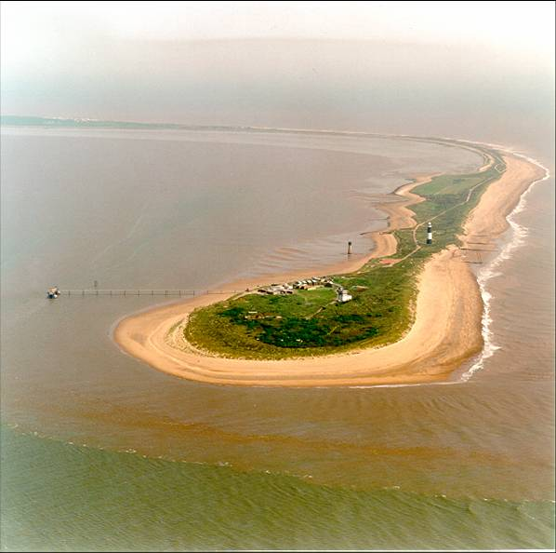
Humber sea level rise + nodal tidal cycle
Figure shows
the annual mean tidal range (solid green line)
the underlying trend (dashed green line)
The trend in mean sea level (dashed blue line)
Notes:
In order to predict historic changes it is necessary to include the dominant forcing conditions.
For the Humber 3 trends or cycles have been shown to be important. These are:
Sea level rise at a rate of about 1.8mm/year – blue dashed line
The lunar nodal tidal cycle which alters tidal range with a period of about 18.6 years – solid green line
A longer term increase in tidal range observed over the last century of about 1mm/year – dashed light green line

Slide 9
The Exercise
Construct a model using the parameters provided, including the historic changes and river input.
Then examine the following scenarios:
With sea level rise of 2mm/year
With sea level rise of 2mm/year, and a nodal cycle of amplitude 0.10m
With an exponential sea level rise from 1900 and a nodal cycle of amplitude 0.10m
With the addition of a reclamation on the tidal flat in the year 2000, reducing the plan area by 2.e7 m3 and the volume by 6.e7 m3

Slide 10
Files for Exercise
Unzip the file ASMITA_practical.zip to your working folder. The zip file should contain:
ASMITA Humber training exercise.pdf – this PowerPoint
Winn et al Humber SMP.pdf – some background material on the estuary
Humber 3EM model parameters.xlsx – spreadsheet of properties to run model
Humber 3EM element parameters.txt – text file of properties that define elements
Matlab LiveScript file: Introduction2Asmita.mlx and associated .m files and installation packages for the Toolboxes and App

Slide 11
Preliminary steps
Develop your own conceptual model of how you think the system works.
Think about how you might represent your conceptual model to study long-term change using ASMITA.
Look at the other resources provided to understand the data available:
Humber 3EM model parameters.xlsx
Humber 3EM element properties.txt
Do you think there is any other data needed?
Make a plan to undertake the exercise
Note: the papers provided:
Winn et al Humber SMP.pdf and The_art_of_modelling_v3.pdf
may help you to develop a deeper understanding of what is required

Slide 12
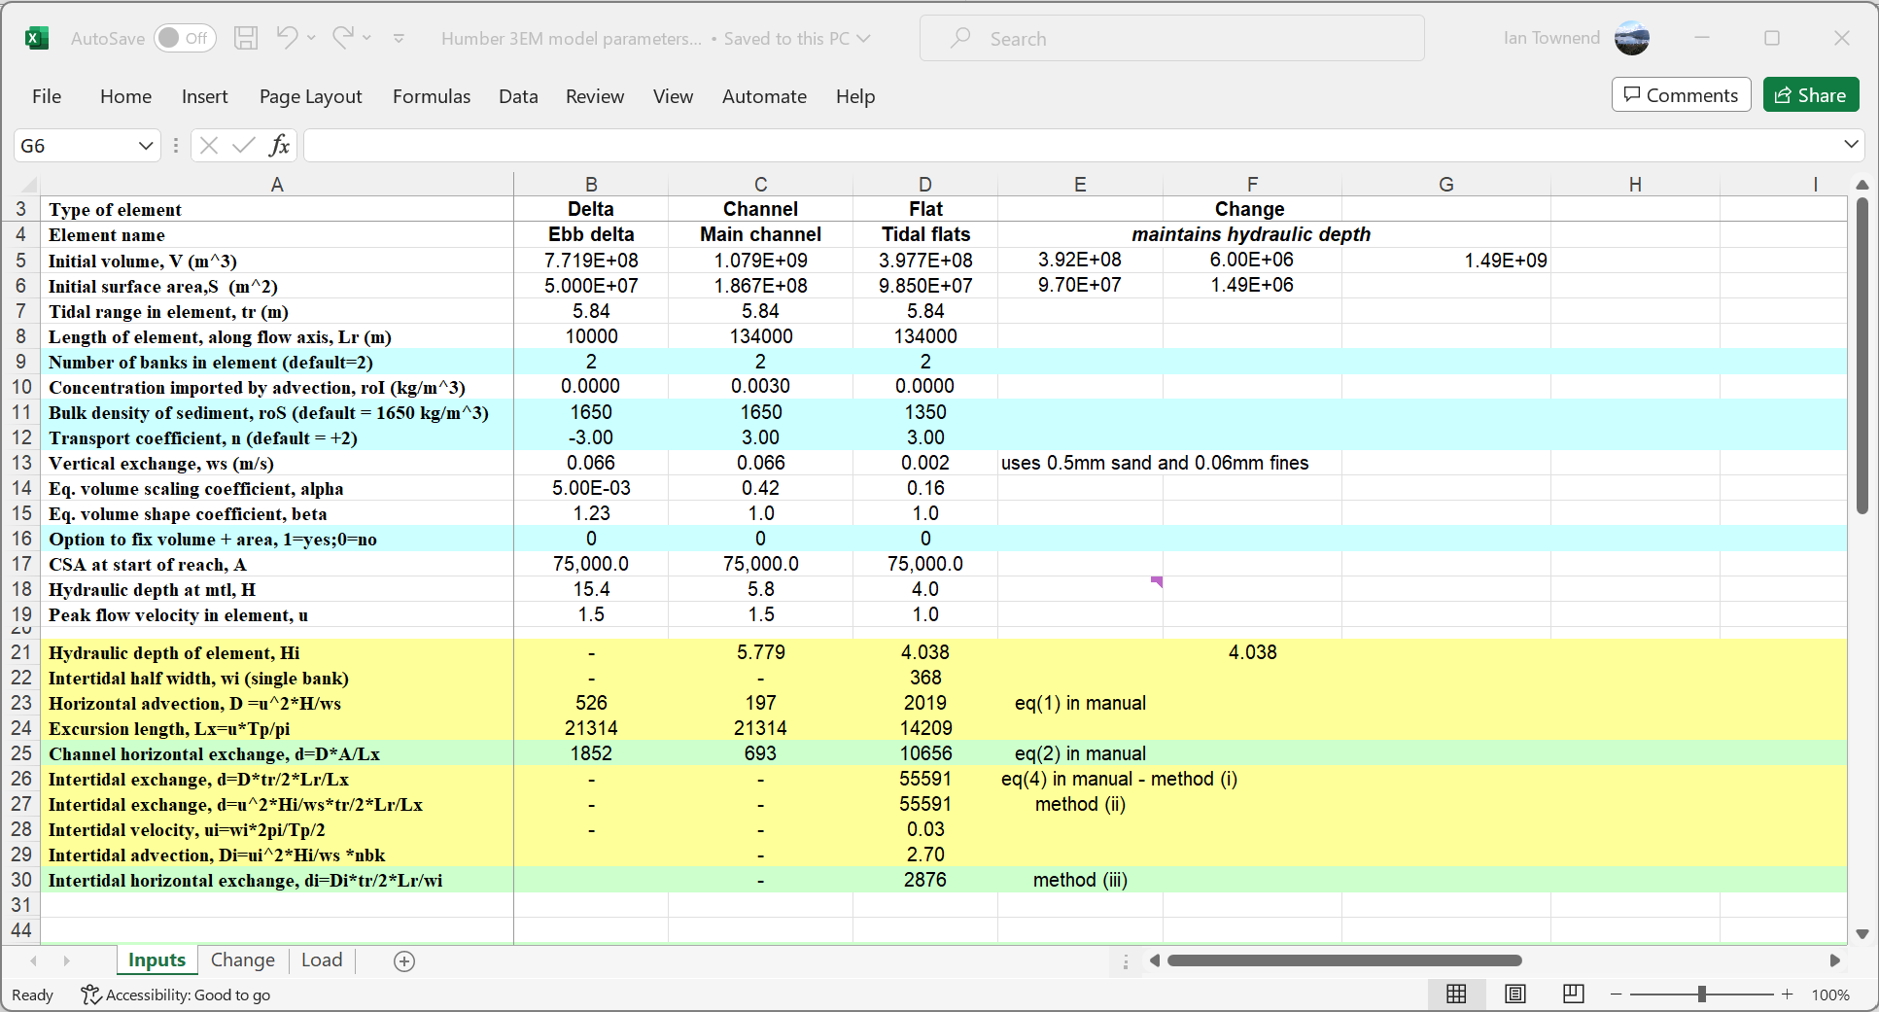
Source data – in file: Humber 3EM model parameters.xlsx

Slide 13
Sketch the model layout and exchanges
River
Sea
Morphological Elements
Global equilibrium concentration
C_{E}
q_{r} + c_{r}
Channel -#1
(V, S, L, w_{s})
q_{r}
Delta – #2
(V, S, L, w_{s})
q_{r}
δ₁₂
δ_{E}
River discharge and concentration if included
δ₂₃
Horizontal exchanges
Draw a sketch of the exchanges between the elements using the values provided in ‘Humber 3EM model parameters.xlsx’
Tidal flat – #3
(V, S, L, w_{s})
V – Volume
S – Plan area
L – Length
w_{s} – vertical exchange

Slide 14
Typical Workflow to Setup Asmita
A typical workflow is to define the Estuary properties and the Elements, including dispersion and water levels. Additions, such as interventions and rivers, are added after Elements have been defined.
The workflow using the Setup menu is typically:
Estuary>System Parameters: define the equilibrium density and check that other parameters that are not needed have default value or are set to 0.
Estuary>Water Levels: define tidal amplitude, rate of sea level rise and nodal cycle (if required).
Elements>Define Elements: define the types of element to be included in the model and give each element a name.
Elements>Element Parameters: define the element parameters for each element (volume, plan area, etc), OR Elements>Load Parameters to load the parameters for all elements from a file.
Estuary>Dispersion: define the horizontal exchange matrix based on the tidal propagation.
Run Parameters>Time Step: define time step, run duration and start year.
Run Parameters>Conditions: set any conditions to be applied to the model run (e.g.. scale to initial values. Only include other options if they have been defined).
Run Parameters>Select Eq. Coefficients: Select the equilibrium coefficients that define the equilibrium volume for each element type (use Generic for this exercise).
This should be sufficient for the model to run, as long as river advection is excluded in the Run Parameters>Conditions.

Slide 15
Extended workflow to add river advection and interventions
To add a river advection:
Rivers>River Inputs: define the model element that the river flows into, the flow rate and the sediment load.
Rivers>River Advection: define the advection matrix (Note: this must result in a mass balance in the flow in and out of each element, ultimately to the sea).
Run Parameters>Conditions: modify the conditions to include the river flow in the run and whether or not to include the river flow in the initial equilibrium, or treat the river flow as a perturbation to the initial condition.
To add interventions:
Interventions>Add or Edit: select the element to apply intervention(s) to. Changes to the volume and/or plan area can be defined for any number of years. Repeat for other elements as required.
Run Parameters>Conditions: modify the conditions to include the interventions in the model run.

Slide 16
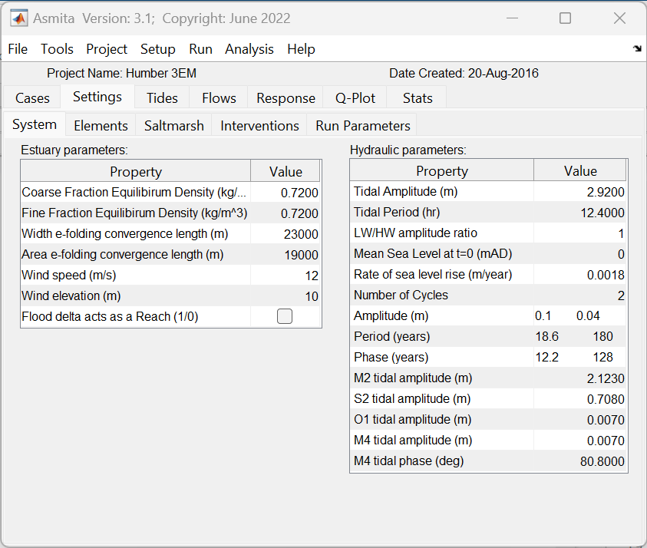
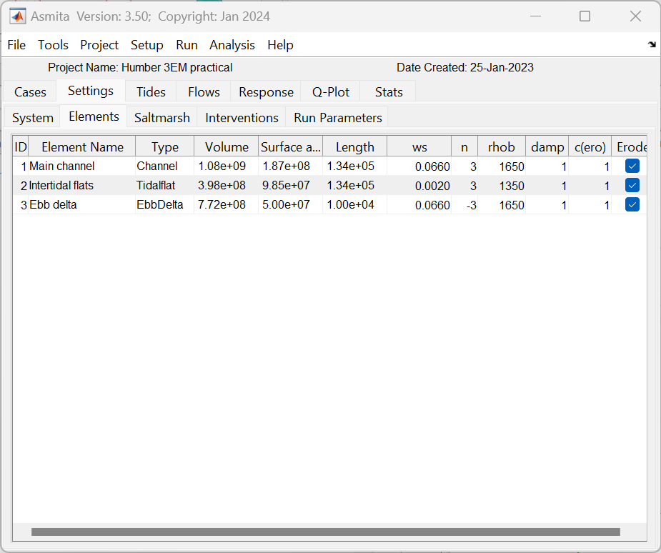
Set-up the model (1) – Schematisation
Estuary parameters, Element parameters, and Water Levels

Slide 17
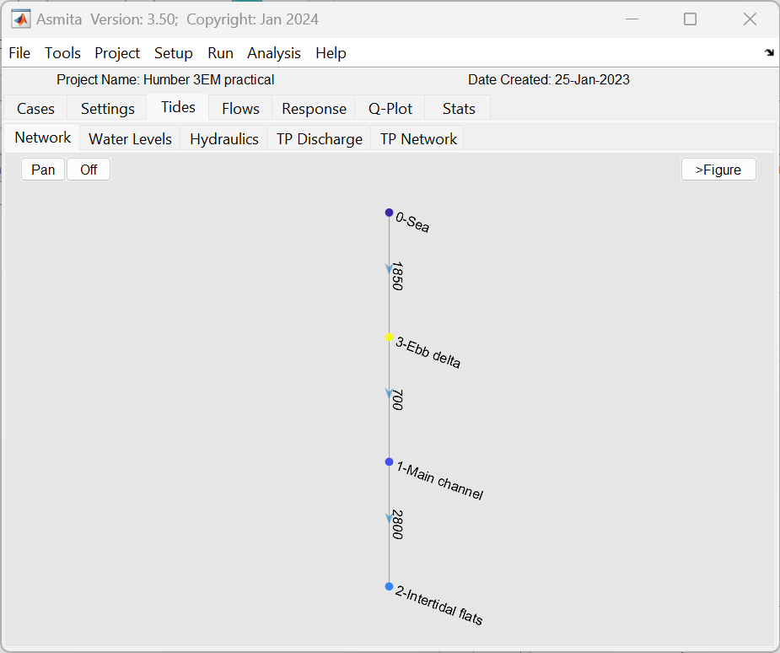
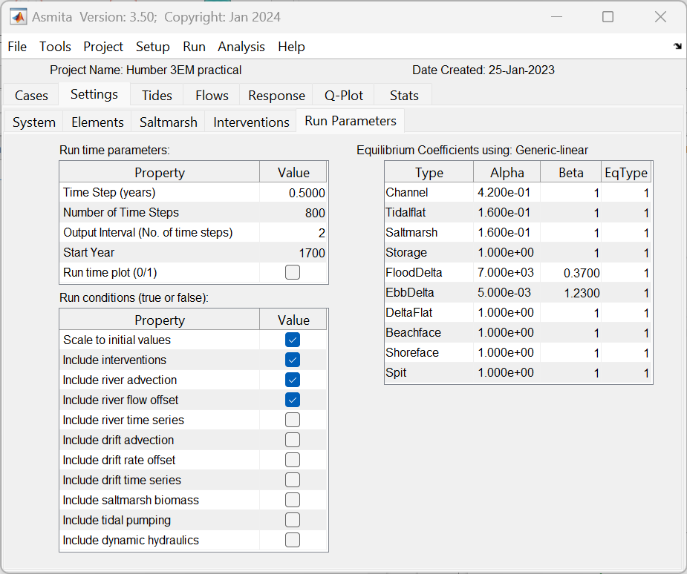
Set-up the model (2) – Network and settings
Horizontal tidal exchange (Dispersion), Run Timestep, Run Conditions and Equilibrium Coefficients

Slide 18
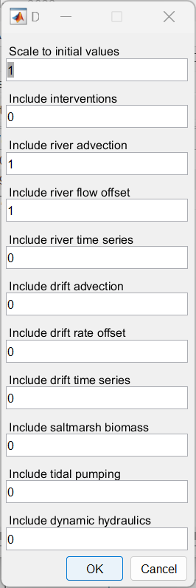
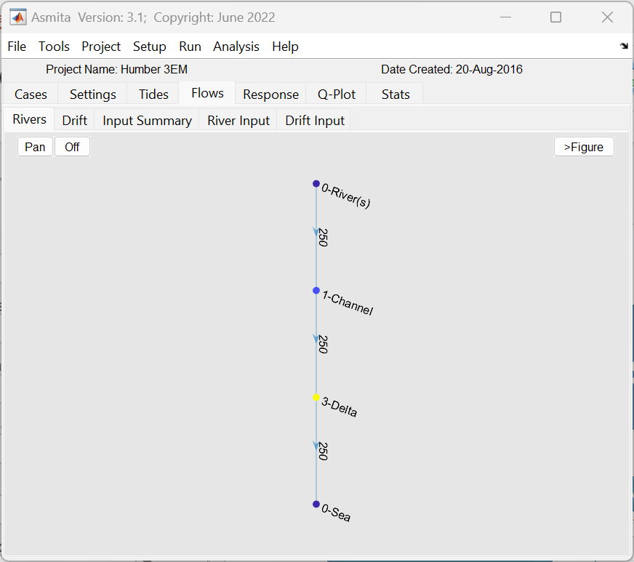
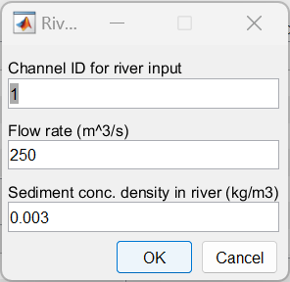
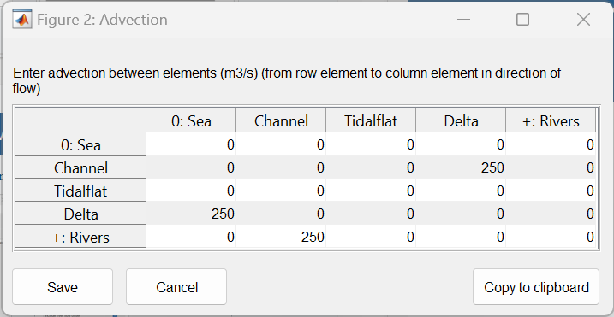
Set-up the model (3) – Advection flows
River input, sediment load, advection flow through system and run conditions

Slide 19
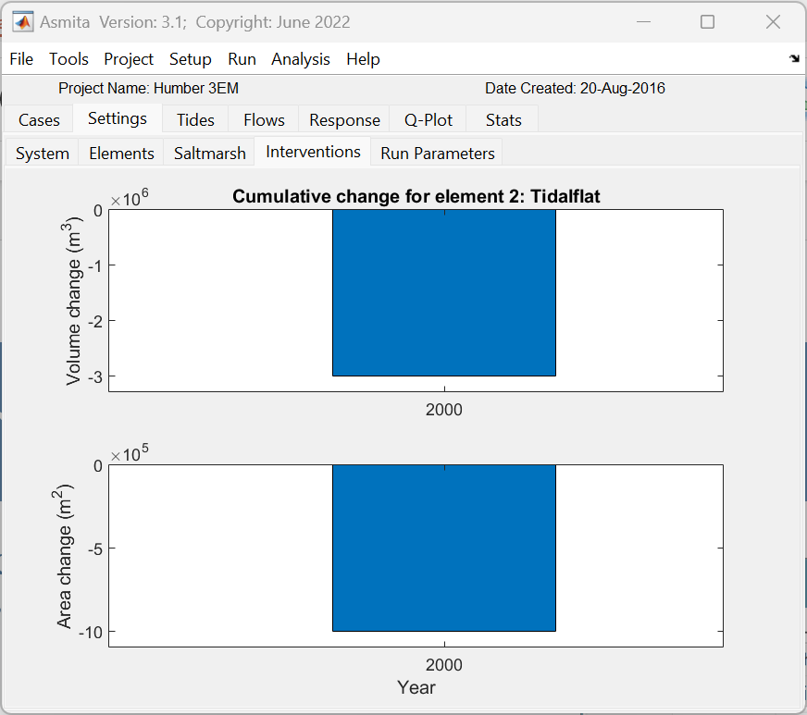
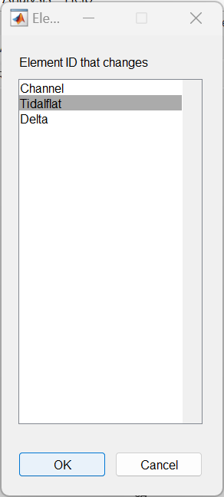
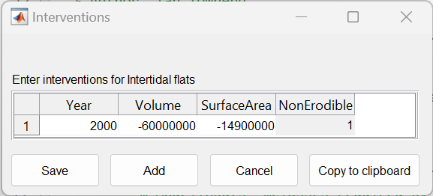
Add in the interventions
Setup>Interventions>Add
to enter changes for specific years
Note: the tidal flat is defined as a water volume (that transport coefficient, n, is positive) and a reclamation reduces the water volume and plan area. Hence, the changes imposed are negative values. It is also permanent and so cannot erode hence the NonErodilbe flag is set to 1.

Slide 20
The Exercise
Construct a model using the parameters provided, including the historic changes and river input.
Then examine the following scenarios:
With sea level rise of 2mm/year
With sea level rise of 2mm/year, and a nodal cycle of amplitude 0.10m
With an exponential sea level rise from 1900 and a nodal cycle of amplitude 0.10m
With the addition of a reclamation on the tidal flat in the year 2000, reducing the plan area by 2.e⁷ m³ and the volume by 6.e⁷ m³.

Slide 21
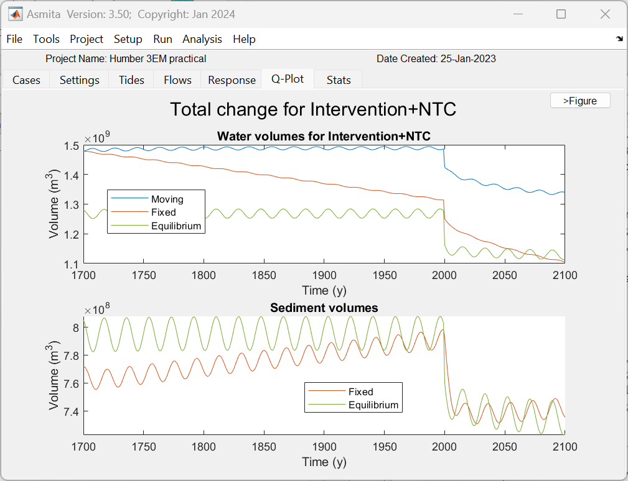
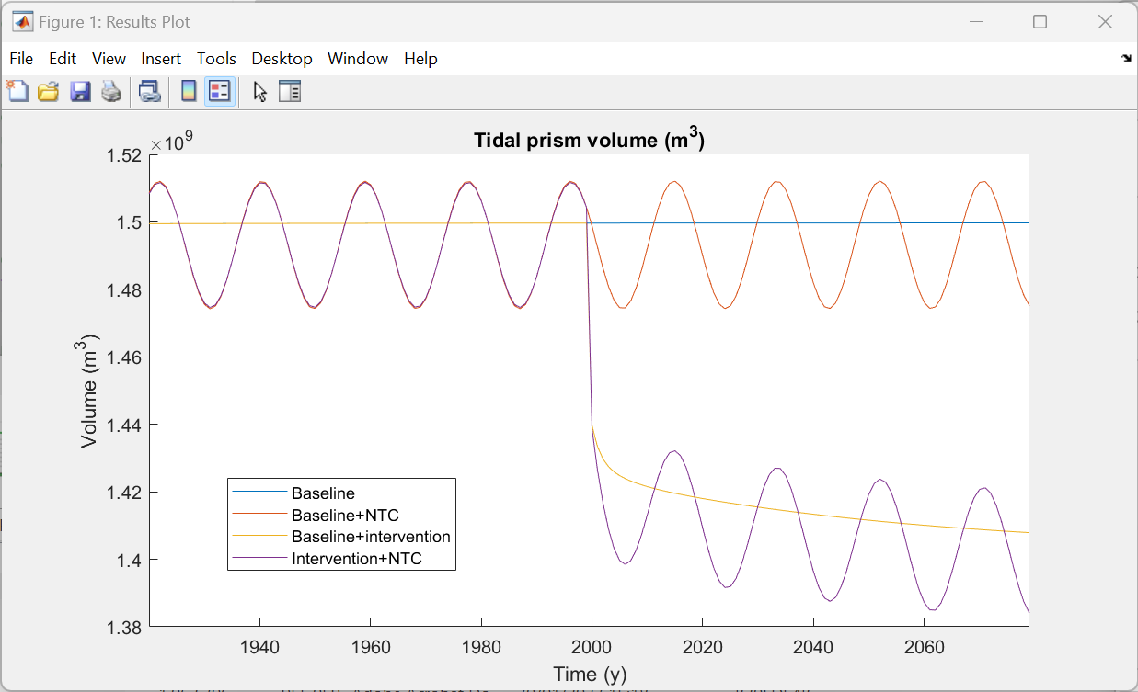
Sample output

Slide 22
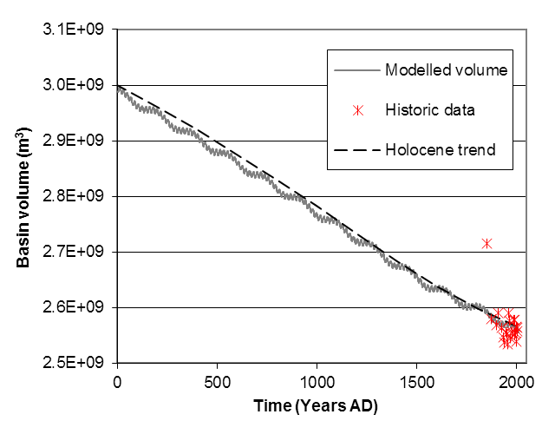
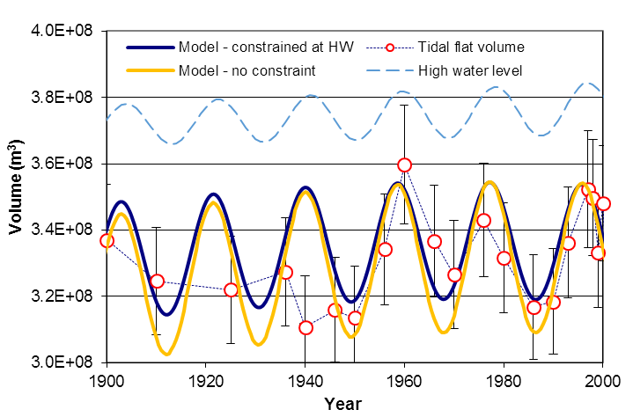
Humber – historical to geological timescales

